Slide 1
Scaling Techniques and Topic Modeling
Prof. Sebastián Vallejo Vera

Slide 2
Changing our focus…
So far, we have been obsessing over tokens (e.g., frequency, dictionaries, complexity) as observable manifestations of concepts. Now we turn to measures that:
  Position texts in vector space
  Derive measures of n latent dimensions based on attributes of j documents:
    For example, ideological placement of parliamentarians based on what they say on the floor.
    For example, bias of newspapers using text from editorials.

Slide 3
Two main ways to scales text:
  Supervised scaling techniques
  Unsupervised scaling techniques

Slide 4
Two main ways to scales text:
  Supervised scaling techniques
  Unsupervised scaling techniques

Slide 5
Unsupervised Learning

Slide 6
Data: humans, documents, votes, etc. are not pre-labelled in terms of some underlying concept.
Think about congressional speeches, we know the author, their party, other metadata, but:
  We don’t yet know what that speech ‘represents’ in terms of its latent properties, what ‘kind’ of speech it is, what ‘topics’ it covers, what speeches it is similar to conceptually, etc.
Goal: take the observations and find hidden structure and meaning in them
  similarity
  groups
  topics
  association between word, etc…

Slide 7
Challenges: Hard to get it Right
Unsupervised learning requires several ad-hoc decisions, and these decisions matter for quality of your results
  number of clusters
  number of topics
  pre-processing steps
Domain knowledge (and honestly a bit of randomness) guides a lot of these decisions

Slide 8
Challenges: Hard to know if you are doing it right
In contrast to supervised approaches, we won’t know ‘how correct’ the output is.
Ther are some statistical measures that gives us some idea of performance, but in general, it will involve a huge amount of qualitative assessment (i.e., validation).
No easy measure of accuracy, recall and precision (note: see next week on supervised model).

Slide 9
Unsupervised scaling models

Slide 10
Let’s think about each document as a vector of word counts (dfm). We can assume that the placement of each word within the text is distributed at random.
  This is clearly false, but that is a basic assumption of the bag-of-words approach.
We can also think what distribution most accurately approximate word usage: Poisson, negative-binomial, etc.

Slide 11
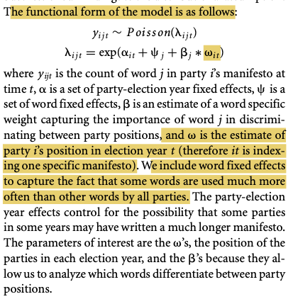
Slapin and Proksch’s (2008) wordfish
⍺ is the logged ratio of the mean word count for a document relative to first document in the data.
ψ is the logged mean of word frequency.

Slide 12
The assumption here is that, indeed, λ is generated by the parameters proposed by Slapin and Proksch (2008).
For example, that β is good at discriminating documents across an a priori assumed dimension:

Slide 13
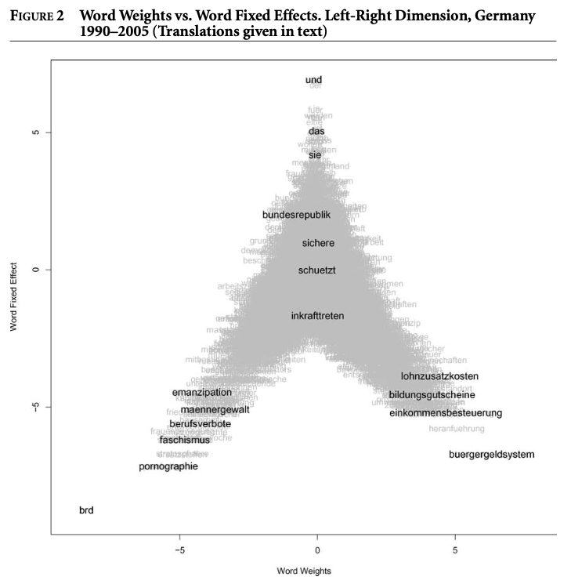

Slide 14
Clustering Methods

Slide 15
Purpose: look for ‘groups’ in data explicitly.
  Input: text + number of clusters
  Output: documents ~> clusters
Clusters: group of data points that are all nearby to each other and far away from other clusters.
Research Questions? How can we categorize these news articles or policy bills? How can we group these legislators based on their speeches?

Slide 16
K-Means Clustering
K-Means clustering: partition the documents into a set of K categories where documents with similar rates of word usage are assigned to the same cluster and dissimilar documents (with dissimilar rates of word usage) are assigned to different categories:
  Pre-specify cluster numbers
  Algorithm puts observations into clusters which minimize the within-cluster sum of squares (i.e., sum of squared Euclidean distances between each data point and its assigned cluster centroid)
  Objective function to minimize

Slide 17
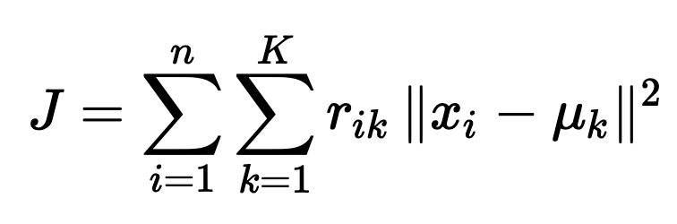
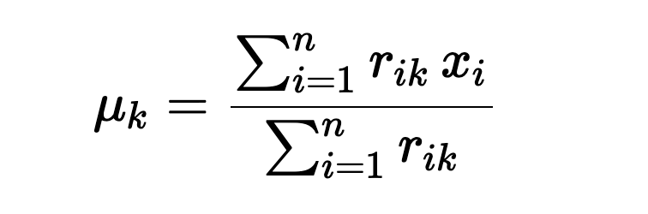
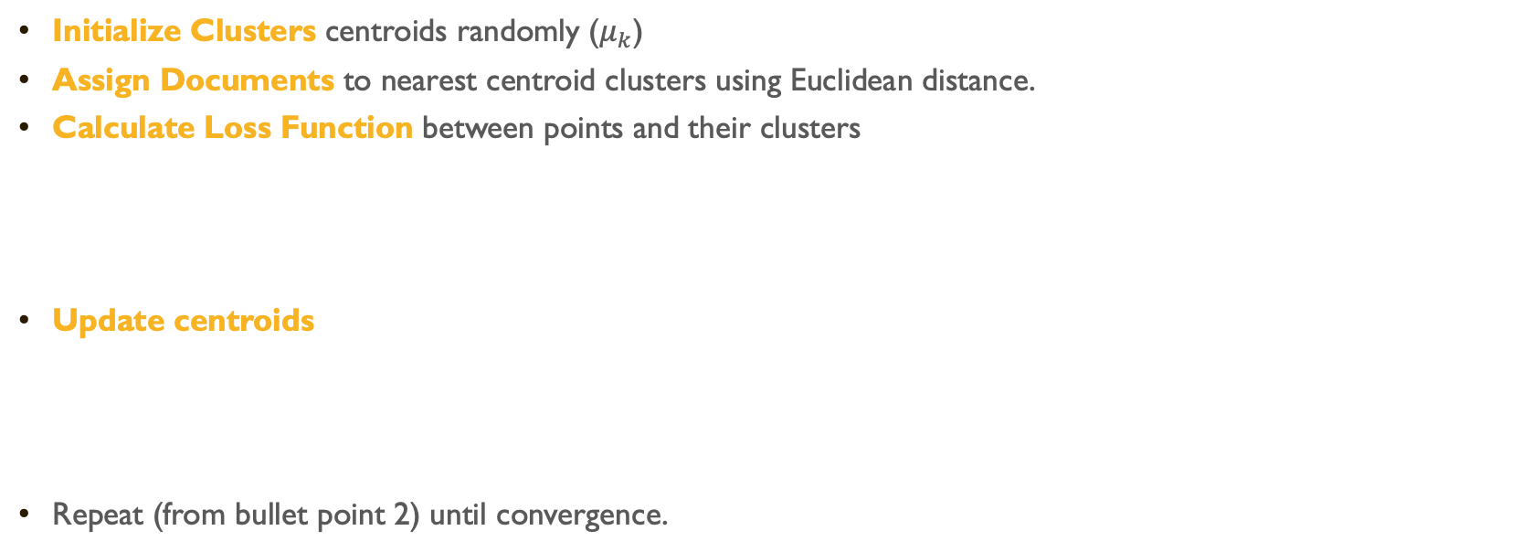
K-Means Steps
Initialize Clusters centroids randomly ($μ_{k}$)
Assign Documents to nearest centroid clusters using Euclidean distance.
Calculate Loss Function between points and their clusters
Update centroids
Repeat (from bullet point 2) until convergence.

Slide 18
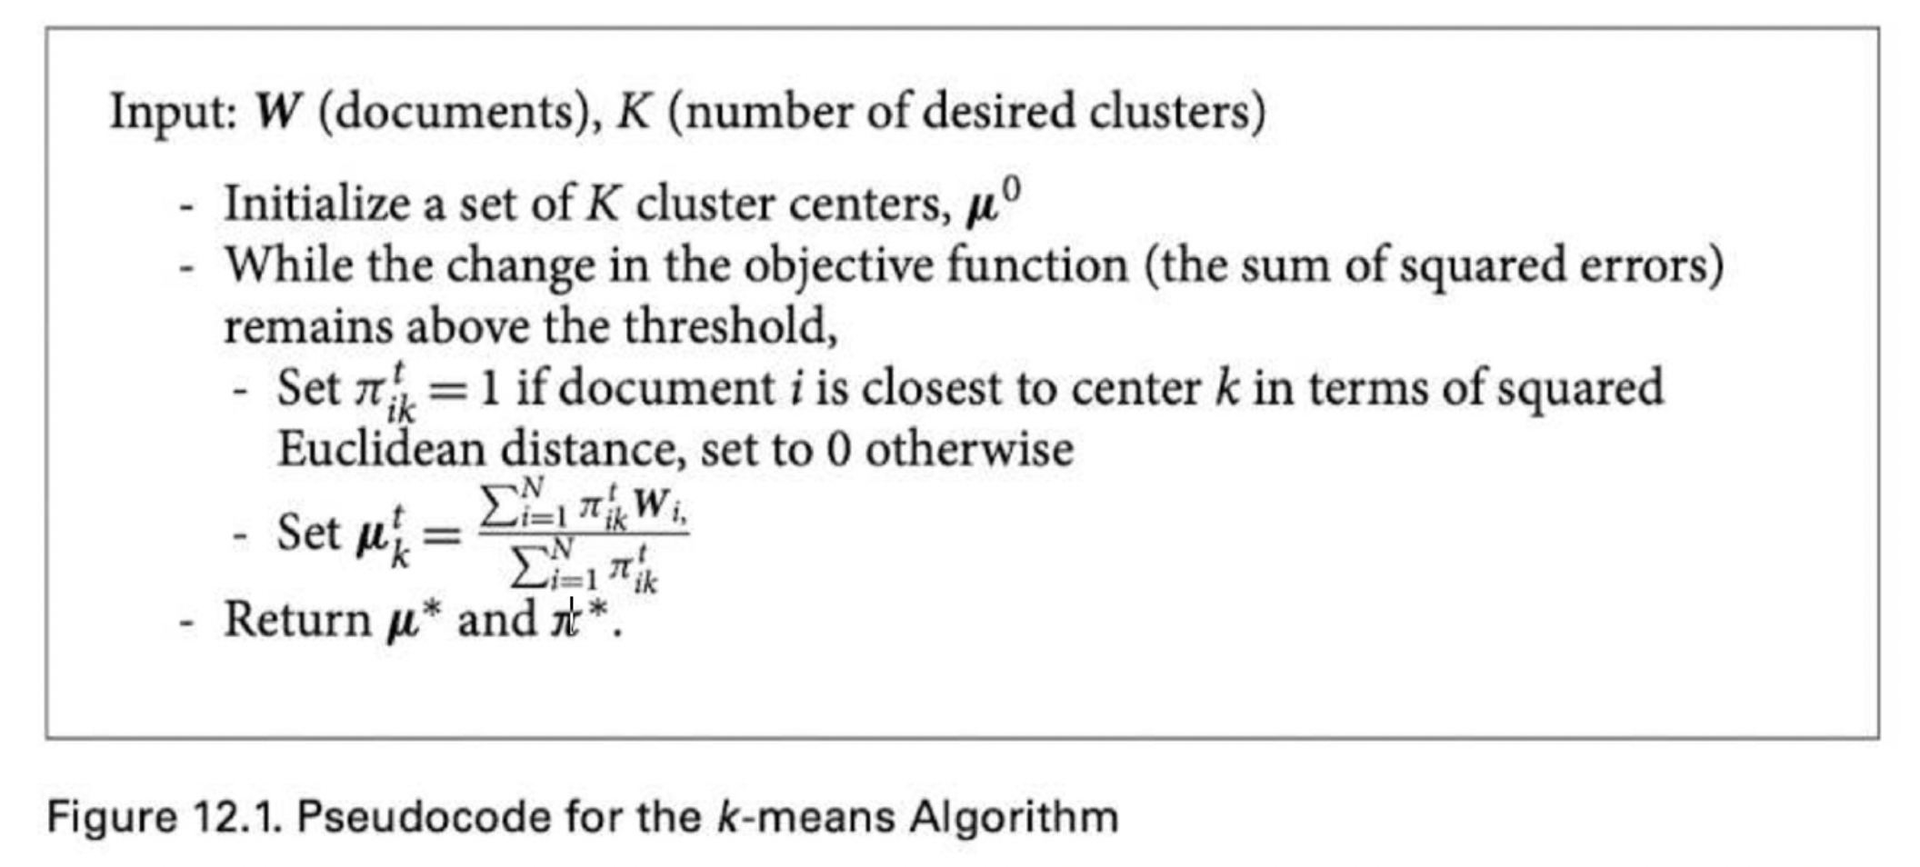

Slide 19
(Unsupervised)
Topic Models

Slide 20
Topics models can be thought as a probabilistic generalization of clustering methods.
Clustering:
  Every document is assigned to a cluster that minimizes a cost function
Topic Models:
  every document has a probability distribution of topics.
  every topic has a probability distribution of words.
  We use likelihood estimation to find the parameters of these distributions

Slide 21
Roberts et al.’s (2014) Structural Topic Models
Topic models are a broad class of Bayesian generative models that encode problem-specific structure into an estimation of categories (Grimmer and Stewart 2013; Blei et al. 2010).
Statistically, a topic is a probability mass function* over words.
The idea of topic models is that each document exhibits a topic in some proportion: each document is a distribution over topics, and each topic is a distribution over words.
* Same as a PDF but for discrete random variable

Slide 22
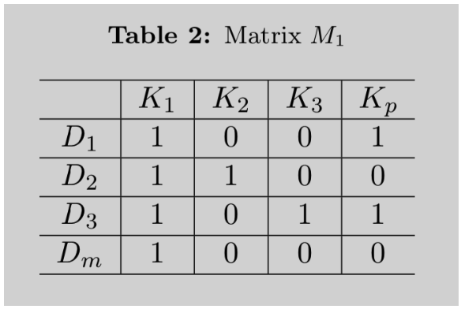

Take a matrix $M_{1}$ such that:
  $m$documents: $D_{1},$ $D_{2},$ $D_{3},$ …, $D_{m}$
  $p$ topics: $K_{1},$ $K_{2},$ $K_{3},$ …, $K_{p}$

Slide 23
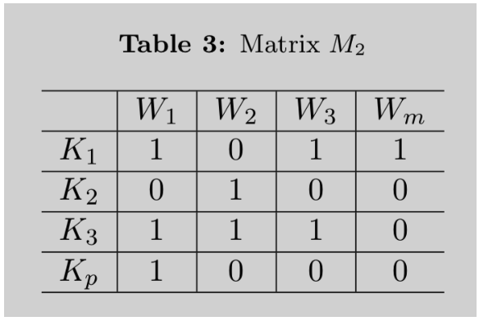

Take a matrix $M_{2}$ such that:
  $m$words: $W_{1},$ $W_{2},$ $W_{3},$ …, $W_{m}$
  $p$ topics: $K_{1},$ $K_{2},$ $K_{3},$ …, $K_{p}$

Slide 24
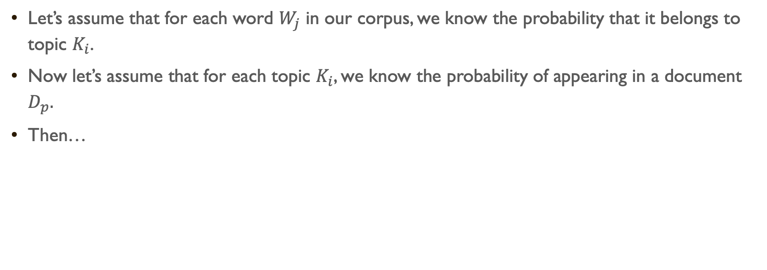
Let’s assume that for each word $W_{j}$ in our corpus, we know the probability that it belongs to topic $K_{i}$.
Now let’s assume that for each topic $K_{i}$, we know the probability of appearing in a document $D_{p}.$
Then…

Slide 25

X
=
$$dtm$$

Slide 26
BUT…
  We need to estimate the probability a word comes from a topic
  We need to estimate the probability a topic appears in a document
  By only observing words and documents.
  And our only input is the number of topics we ask the model to finds
HOW?
Variational inference of variational Bayes inference

Slide 27
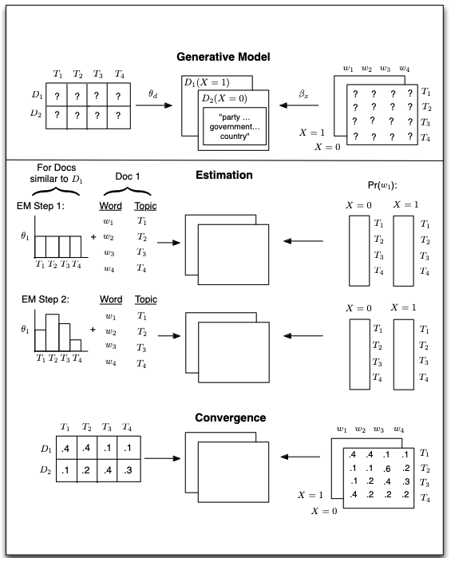

Slide 28

Intuitively, we define a data generating process for each document and then use the data to find the most likely values for the parameters within the model.
The generative model begins at the top, with document-topic and topic-word distributions generating documents that have metadata associated with them ($X_{d}$, where d indexes the documents).

Slide 29

A topic is defined as a mixture over words where each word has a probability of belonging to a topic.
A document is a mixture over topics, meaning that a single document can be composed of multiple topics.

Slide 30
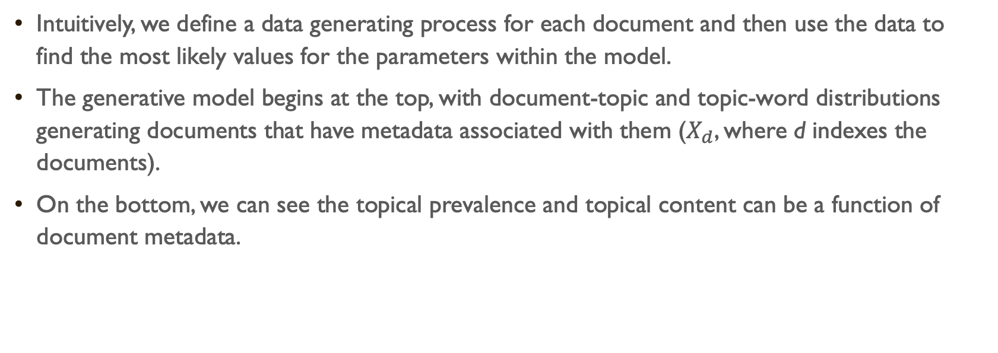
Intuitively, we define a data generating process for each document and then use the data to find the most likely values for the parameters within the model.
The generative model begins at the top, with document-topic and topic-word distributions generating documents that have metadata associated with them ($X_{d}$, where d indexes the documents).
On the bottom, we can see the topical prevalence and topical content can be a function of document metadata.

Slide 31



Document metadada
Topical content refers to the words used within a topic
Topical prevalence refers to how much of a document is associated with a topic

Slide 32
And “that’s it”…
Topic models in general, and STMs in particular, are useful:
  Helps us classify large corpora by topics (either known or unknown)
    Examples?
  Helps discover possible topics (i.e., reverse engineer the topic generating process), particularly helpful when these are partially unknown.
    Examples?

Slide 33
Idiosyncratic view on topic models

Slide 34
STM revolutionized the application of computational text-analysis techniques in the social sciences.
There have been, however, important critiques on the instability of the models and the problems with post-hoc decisions made by researchers to accommodate their needs (not Roberts et al.’s fault).
  My experience with STM models has been… not good.
More importantly, I believe that the current advancement in transformers-based machine learnings and GPT models can provide better results with the same effort and low cost.

Slide 35
That said, even with my particular idiosyncratic view on the topic (as well as my experience with these models), I also believe that it is important to understand the intuition behind these models (and how to apply them).
So, after what? [look at wrist with no watch] two hours? of whatever this class was? let’s see how to run these beibi!
But, lest I forget:

Slide 36
Today’s Readings
Did the paper answer the research question?
Was the data appropriate for answering that question?
Was the method appropriate for answering that question?
Are the conclusions arrived at by the author supported by `their evidence?

